Slide 1
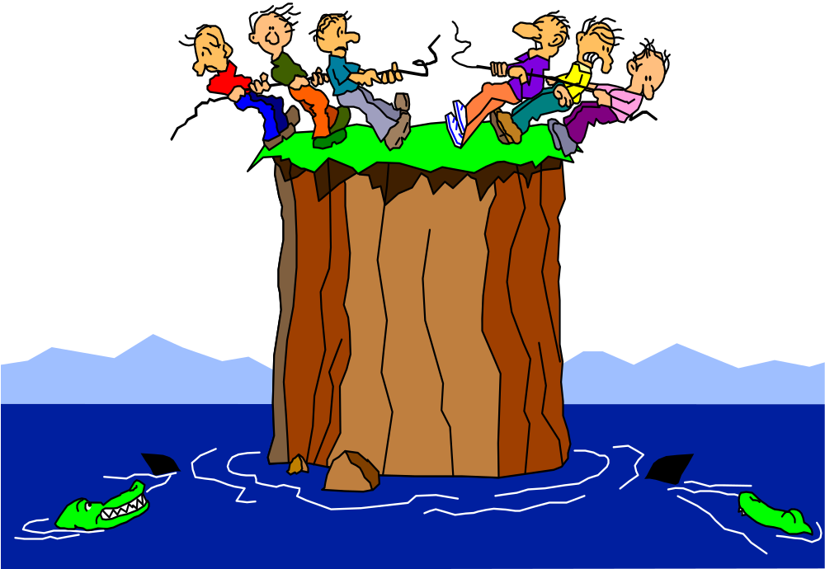
Fear – the destroyer of the public speaker!

Slide 2

Focus on the audience not on how you feel!

Slide 3

Nerves are good!

Slide 4

Get your presentation off to a flying start!

Slide 5

Seven signs of a successful speaker

Slide 6

1. Structure

Slide 7

2. Pitch, pace, pause NOT boring your audience to death!

Slide 8

3. Eye contact

Slide 9

4. Animation

Slide 10
5. Keep it simple
1 AND 1 = 2

Slide 11

6. Enthusiasm

Slide 12

7. Rehearsal

Slide 13
Death by PowerPoint
PROJECT MANAGEMENT IS A TOUGH ROLE. YOU OFTEN FIND YOURSELF BEING PULLED BETWEEN KEEPING USERS, SUBORDINATES, TEAM MEMBERS AND SENIOR PEOPLE HAPPY. GIVEN THESE DEMANDS, WHAT DO THE BEST PROJECT MANAGERS DO THAT MAKES THEM STAND OUT FROM THE CROWD? PROBLEM SOLVING AND BREAKING THROUGH CONSTRAINTS IS AN ESSENTIAL PART OF MANAGING PROJECTS. THOSE THAT EXCEL AS PROJECT MANAGERS HAVE A MIND-SET WHERE THEY FOCUS ON FINDING SOLUTIONS TO PROBLEMS. THEY KEEP ASKING THEMSELVES HOW THEY CAN OVERCOME WHATEVER BARRIERS ARISE. ALL THE BEST PROJECT MANAGERS UNDERSTAND THE NEED TO COMMUNICATE AND CONSULT. THEY ALSO KNOW THAT LOTS OF TALKING AND PROCRASTINATION ACHIEVES NOTHING. FINDING THE RIGHT BALANCE BETWEEN CONSULTING, DECIDING AND ACTING IS WHAT SEPARATES THE BEST FROM THE REST. IN EVERY PROJECT THERE ARE CUSTOMERS. THEY MIGHT BE INTERNAL OR EXTERNAL OR A COMBINATION OF BOTH. THE BEST PROJECT MANAGERS KEEP CUSTOMERS AT THE FOREFRONT OF THEIR MIND. THEY LISTEN EFFECTIVELY, TAKE ON BOARD THE FEEDBACK THEY ARE GETTING AND LOOK FOR WAYS OF INCORPORATING IT WHENEVER THEY CAN. IN ANY PROJECT THERE WILL BE MANY STAKEHOLDERS, ALL OF WHOM WILL SEE THEIR ISSUES AS BEING THE MOST IMPORTANT. THE CHALLENGE THAT THE BEST PROJECT MANAGERS RESPOND TO IS FINDING SOLUTIONS THAT ADDRESS THE ISSUES WITHOUT COMPROMISING THE OVERALL PROJECT STRUCTURE. PROJECT MANAGERS NEED TO LEAD BY EXAMPLE. THE EXAMPLE THEY SET DETERMINES HOW THE REST OF THE TEAM BEHAVE AND RESPOND TO THE CHALLENGES THAT ARISE. THOSE PROJECT MANAGERS WHO WANT TO ENCOURAGE OPENNESS AND HONESTY ARE OPEN AND HONEST THEMSELVES. THOSE THAT TAKE RISKS AND LEARN FROM THEIR MISTAKES EMPOWER OTHERS TO DO THE SAME. YOU CAN SET OUT THE BEST PLANS IN THE WORLD, THINK ABOUT THE RISKS, PUT GREAT TRACKING IN PLACE AND EVEN THEN THE UNEXPECTED WILL SHOW UP FROM TIME TO TIME. ADAPTABILITY IS A KEY CHARACTERISTIC OF THE BEST PROJECT MANAGERS. VIEW ADAPTABILITY IN PROJECTS A BIT LIKE THE FLIGHT PATH OF AN AIRCRAFT. IT CAN BE OFF COURSE ALONG THE WAY BUT IT NEEDS TO BE RIGHT ON TARGET WHEN IT COMES TO LANDING. THOSE THAT EXCEL AS PROJECT MANAGERS REALIZE THEY CANNOT DO IT ALL ON THEIR OWN. THEY RECOGNIZE THE IMPORTANCE OF THE COLLECTIVE TEAM EFFORT IN GETTING RESULTS. THEY FIND AND UTILIZE THE STRENGTHS IN EVERYONE AND TRY TO ENSURE THAT THEY ALLOCATE ROLES TO THOSE BEST PLACED TO DELIVER. THEY LEARN TO KEEP EVERYONE MOTIVATED AND PUSHING THE BOUNDARIES TO GET RESULTS. PROJECT MANAGEMENT IS A COMPLEX AND DEMANDING ROLE. STARTING TO WORK ON THESE 7 HABITS CAN TAKE YOU TO THE NEXT LEVEL.

